Slide 1
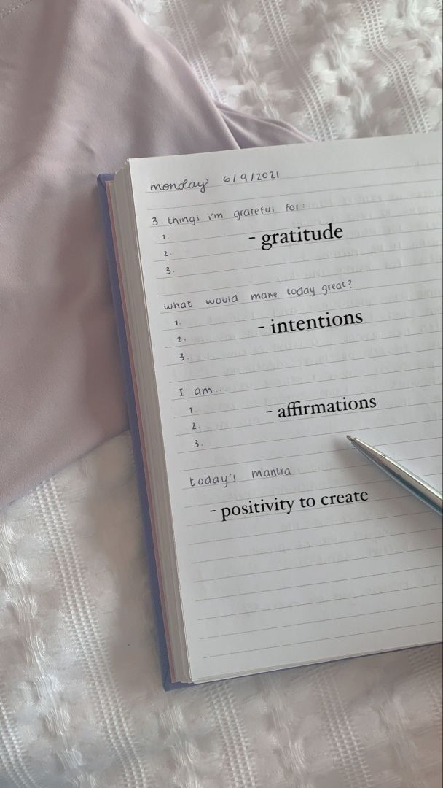
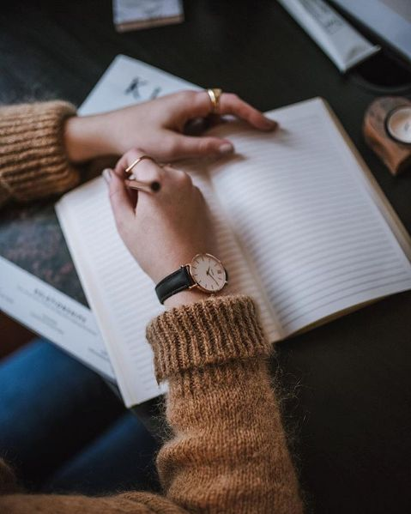

Booked & Balanced
Plan Your Day, Write your Story
we create beautifully crafted planners designed to help you stay organized, inspired, and focused every day.
From daily schedules and goal-setting to manifestation exercises and personal reflections,
our planners are the perfect companion for capturing your thoughts, dreams, and aspirations."
Manifest
Track
Life Log

Slide 2
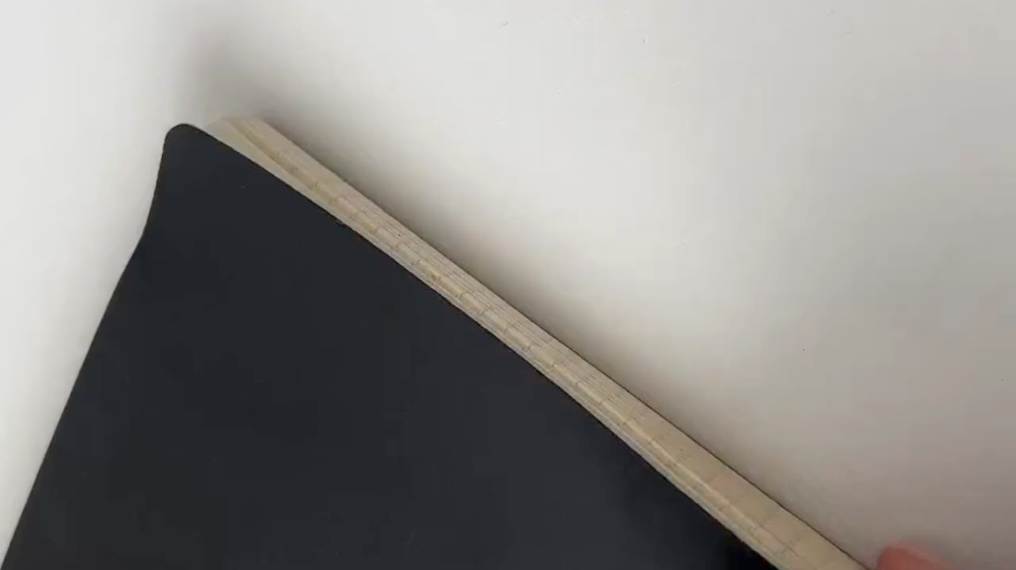
YOUR PERSONAL GPS

Slide 3

Founder: Simran Padelkar
Hi, I'm Simran Padelkar, the founder of Booked and Balanced. Like many others, I struggled with planning and organizing my daily life, often feeling overwhelmed by the chaos. I realized there was a real gap in the market for products that could help people stay organized while also staying inspired. To fill this gap, I decided to start my own brand — one that blends practicality with creativity, helping individuals take control of their time, set meaningful goals, and achieve their dreams. Through our planners, diaries, and tools, I hope to empower others to organize their days and manifest their goals, just as I have learned to do.
What Our Brand Offers
Daily Planner
Manifestation Journal
Daily Journal

Slide 4
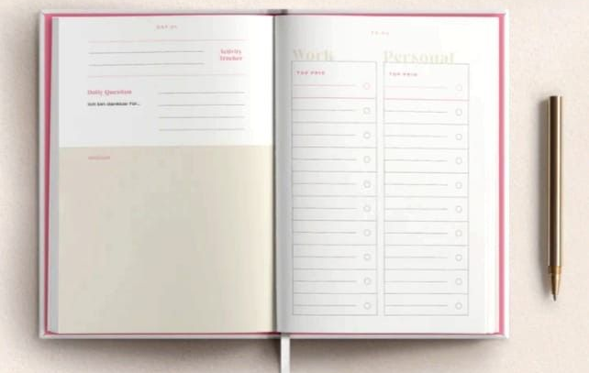
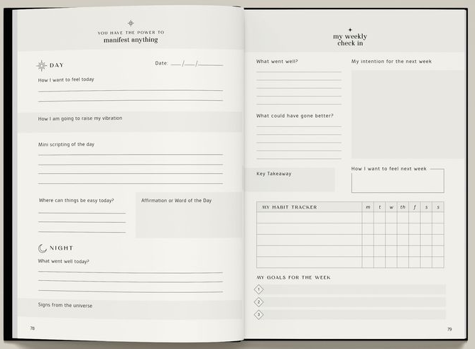
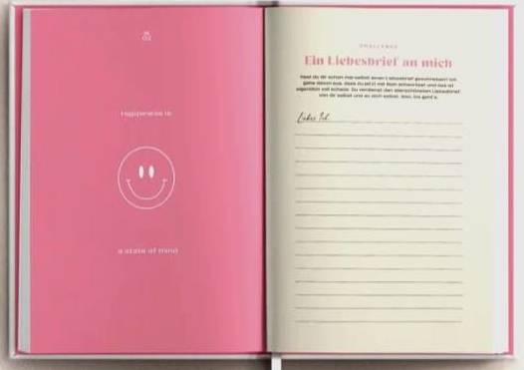
Daily Planner Our Daily Planner is the perfect tool for structuring your day. You can easily plan your activities, prioritize tasks, and track your progress, ensuring you stay on top of everything, from work to personal goals. With space to manage appointments, to-do lists, and notes, it helps you stay productive and focused every day.
Manifestation Journal The Manifestation Journal is where you can align your thoughts and intentions with your dreams. Whether you’re setting new goals or reflecting on your aspirations, this journal encourages you to visualize and manifest the life you want
Daily Journal Our Daily Journal is your personal space to reflect and process your thoughts. Treat it as a trusted friend — where you can write about the events of your day, your emotions, and your experiences. This journal helps you track your growth,release stress, and look back on the meaningful moments that shape your life

Slide 5

Daily Planner
₹. 699.00
Product Features
• Dimensions: 7" x 8.5" x 1.5" • Weight: 650g • 100 GSM paper • 240 GSM textured paper • Gold foiling accents • Gold wire-o binding • Faux croc textured hardbound cover • Month tabs
What's Inside • 2024 at a glance • 12 month pages • Monthly calendars • Daily calendars • Goal planner • Monthly goal planner • Monthly habit tracker • Monthly reflections • End of year reflections

Slide 6
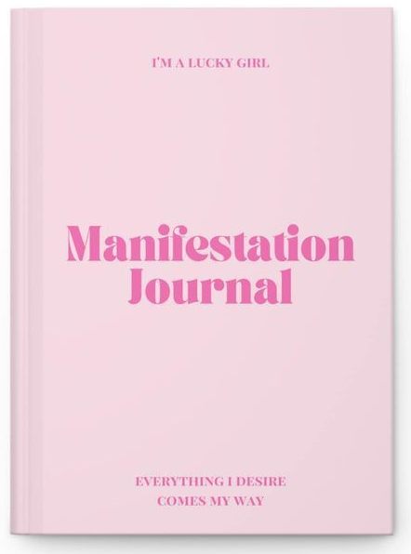
Manifestation journal
₹. 699.00
Product Features
• Dimensions: 7" x 8.5" x 1.5" • Weight: 650g • 100 GSM paper • 240 GSM textured paper • Gold foiling accents • Gold wire-o binding • Faux croc textured hardbound cover • Month tabs
What's Inside • Vision Statement • Daily Affirmations • Gratitude List • Goal Setting • Visualization Exercises • Manifestation Intentions
• Self-Love & Empowerment

Slide 7

Daily journal
₹. 699.00
Product Features
• Dimensions: 7" x 8.5" x 1.5" • Weight: 650g • 100 GSM paper • 240 GSM textured paper • Gold foiling accents • Gold wire-o binding • Faux croc textured hardbound cover • Month tabs
What's Inside
• Date & Day of the Week
• Events & Happenings of the Day
• Interactions & Conversations
• Challenges or Obstacles • Highlights of the Day
• Lessons Learned

Slide 8
OUR MISSION
At Booked & Balance we believe that journaling is a powerful tool for nurturing mental health. Our journals help you express your thoughts, reflect on your day, and manifest your goals, providing a safe space to release stress, gain clarity, and foster positive growth. Through consistent practice, our journals support emotional well-being, self-awareness, and resilience, empowering you to lead a more mindful,balanced life.
millions of Indians have started journaling over the last 5 years.
If we consider the stationery market growth, mental health awareness,
and online social media influence, it's likely that at least 10-20 million
in India have incorporated journaling into their routines in some form over
The past few years.

Slide 9
Thank You

